Slide 1

Survey Data Analysis
SOUTHEAST AIRLINES
Zeyang Zhou
Michelle Ke Kincaid
Rayanna Harduarsingh
Divya Bhuwansingh Damahe

Slide 2





AGENDA
Business Questions
Analysis of data
Root cause analysis
Actionable Insights
This Photo by Unknown Author is licensed under CC BY

Slide 3
BUSINESS QUESTIONS
1.What are the factors contributing to high NPS score?
2.How does NPS score vary by geographic location?
3.How does NPS score vary by age?
4.Depending on the data, who is a better partner?
1.Does Southeast Airlines need to adjust the number of their partners?
5.What factors contribute to low scores?
6.How can we improve the NPS Score?

Slide 4
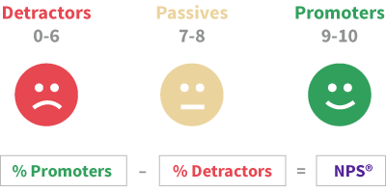
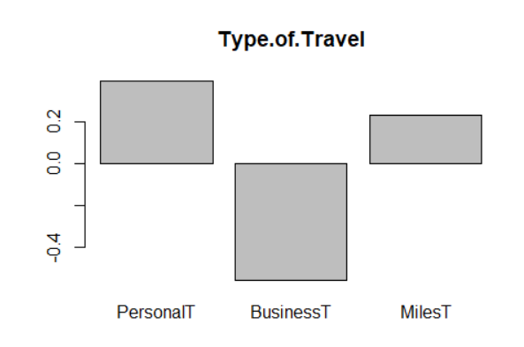
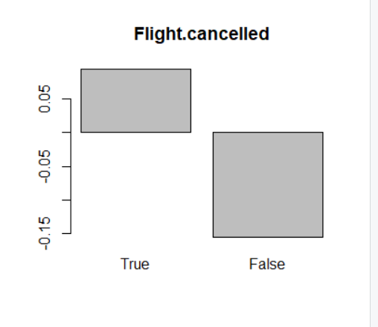
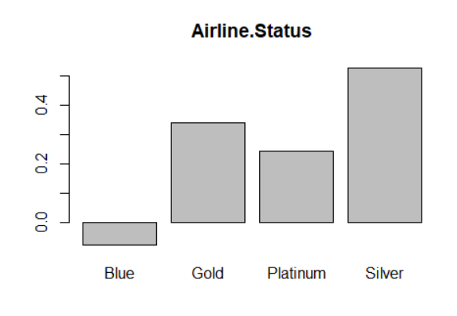
Current Net promoter score is ~8.90

Slide 5
Linear relationship
Likelihood to recommend
Airline status
.
.
Likelihood to recommend
Type of Travel
.
Airline status
.
Gender
Likelihood to recommend
Type of Travel
.
.
10%
30%
36%

Slide 6
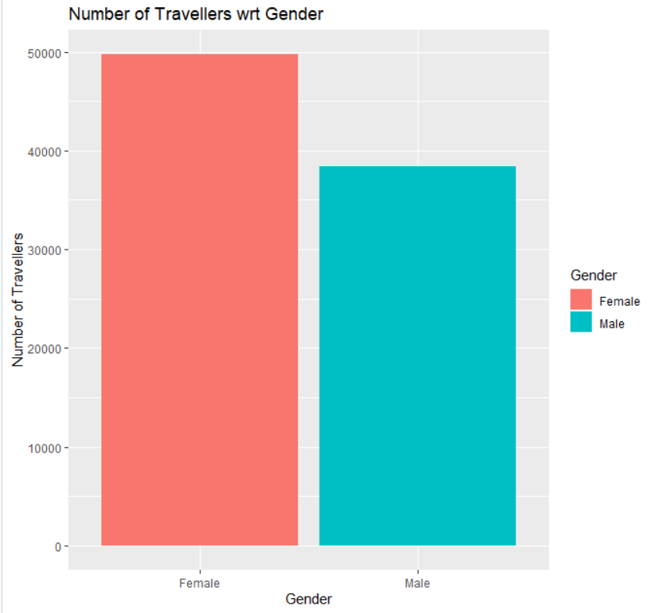
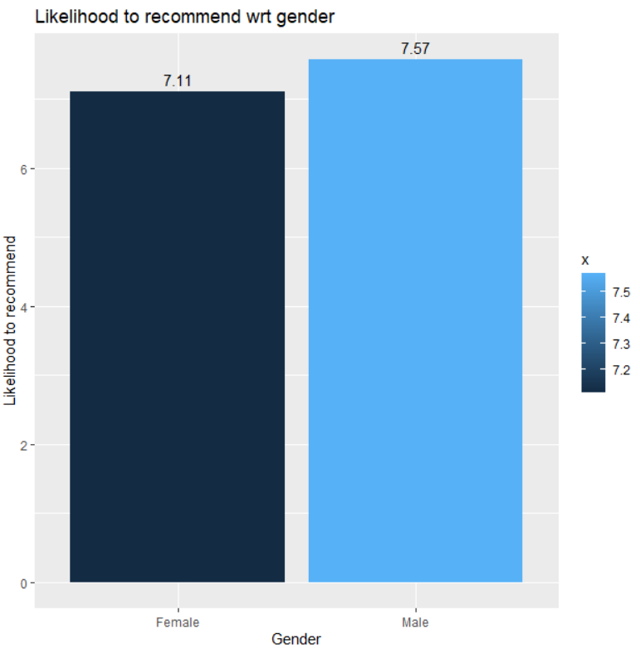
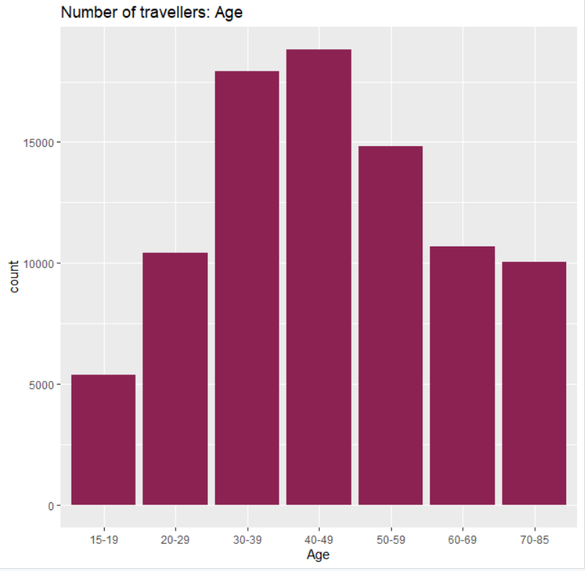
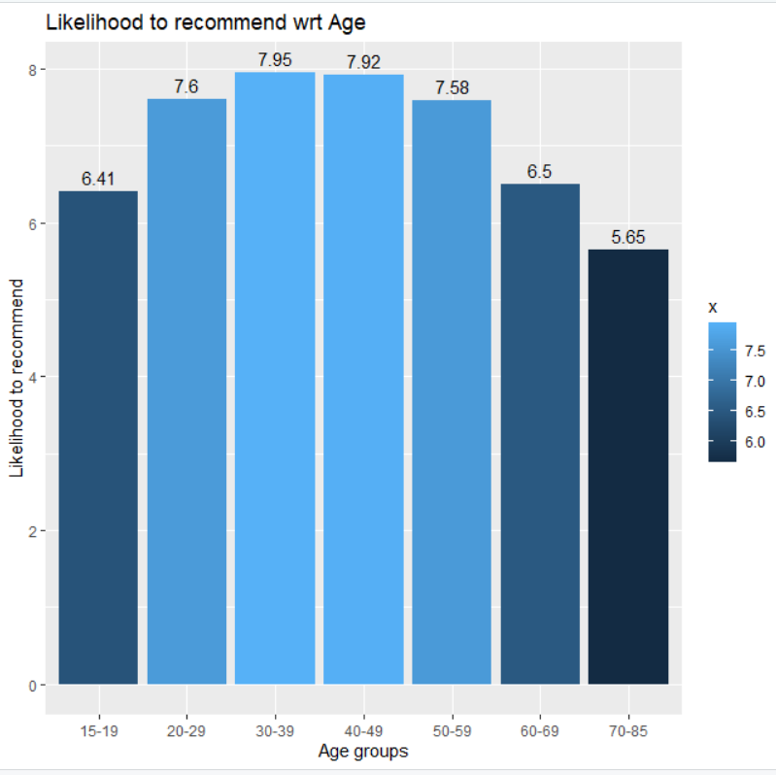
likelihood to recommend with respect to Gender and location
Notes:
There wasn’t a strong linear relationship between likelihood to recommend and the columsn so we divided them into bins to get more clarity
Eating and drinking at airport
Type of travel

Slide 7
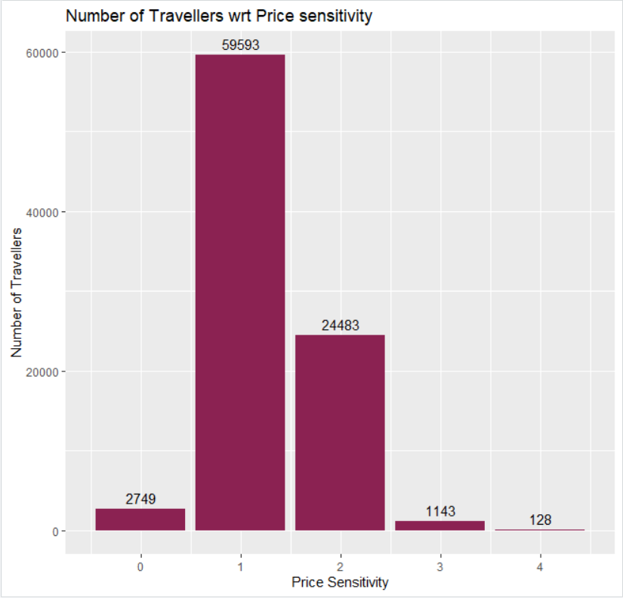
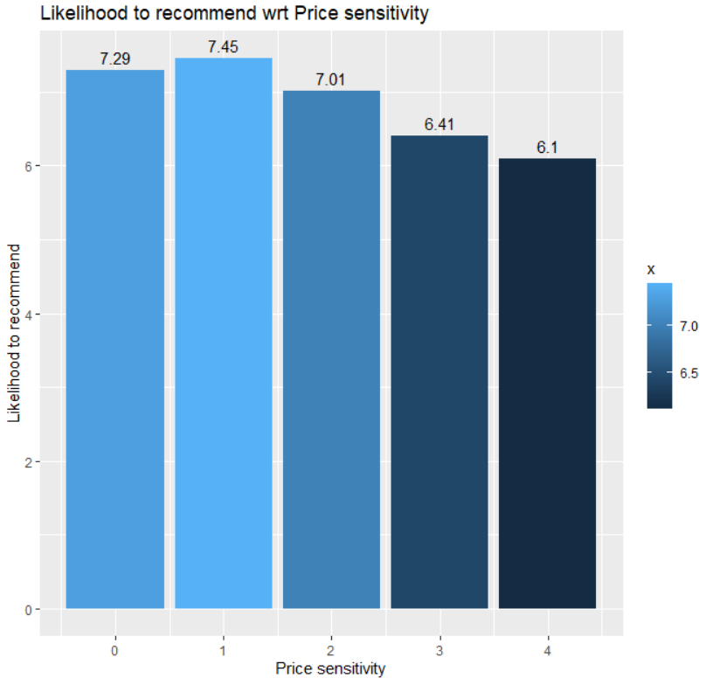
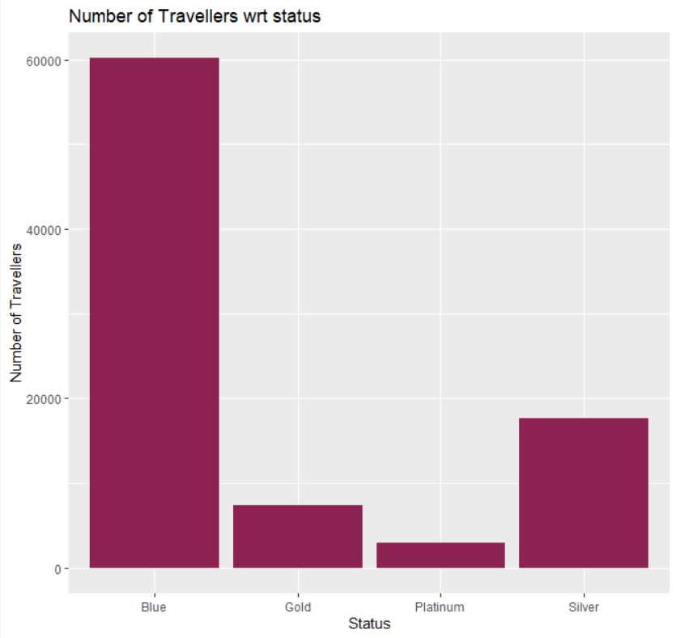
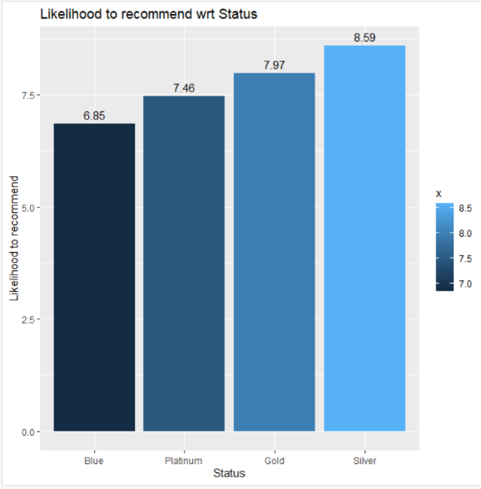
likelihood to recommend with respect to Age and Airline status
Notes:
Eating and drinking at airport
Type of travel

Slide 8
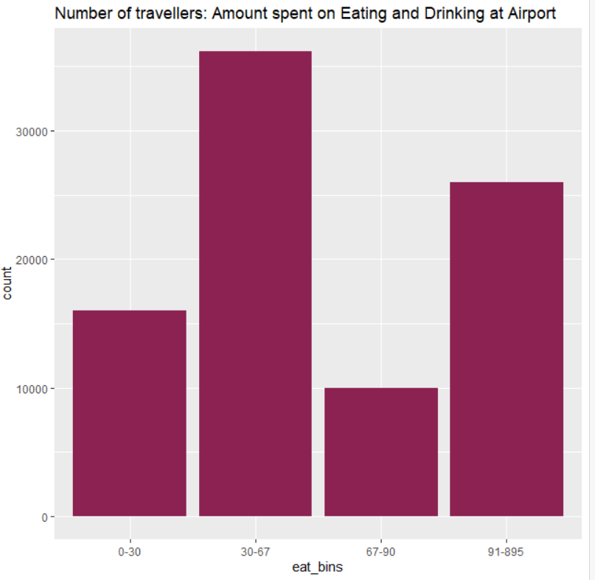
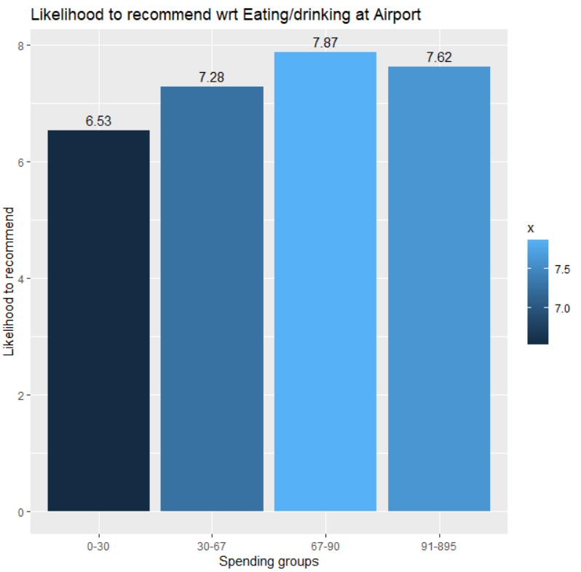
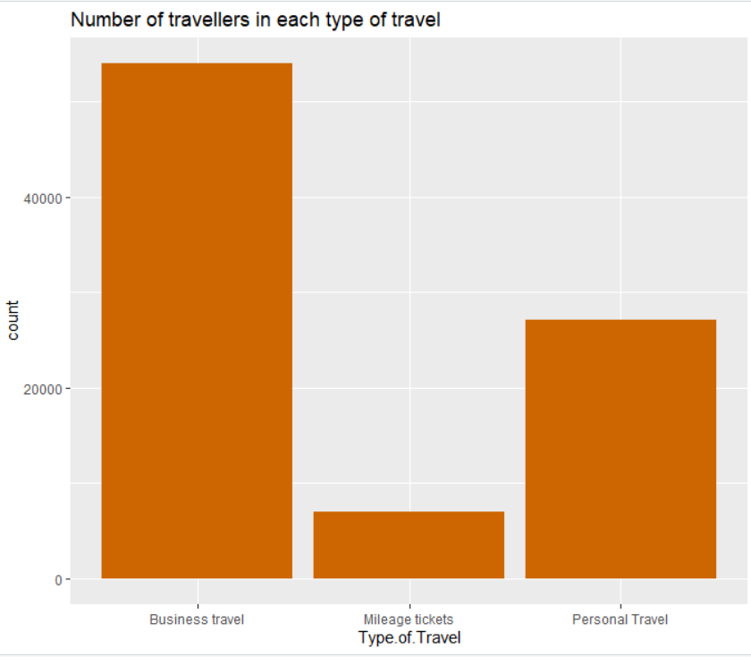
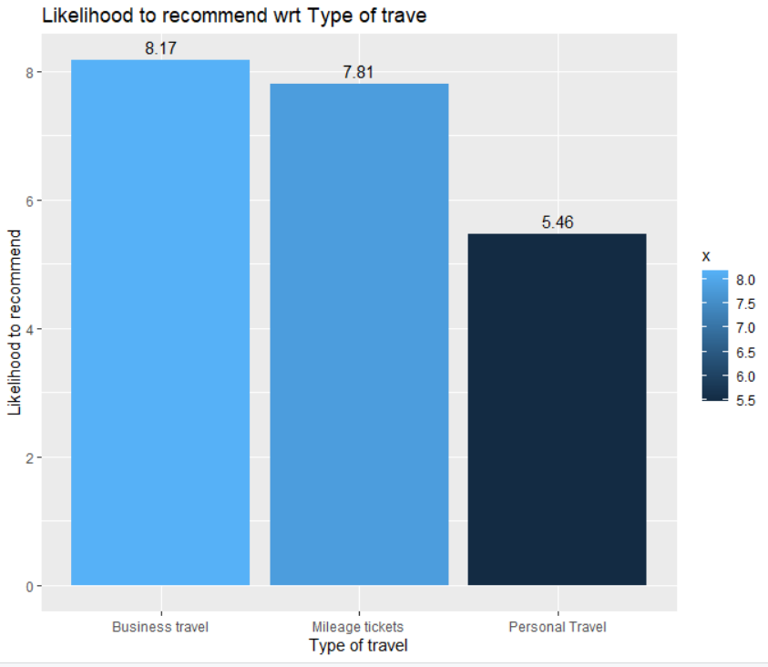
likelihood to recommend with respect to Age and Airline status
Notes:
mean likelihood to recommend for people who don’t spend on eating and drinking at the airport- is 6.42

Slide 9
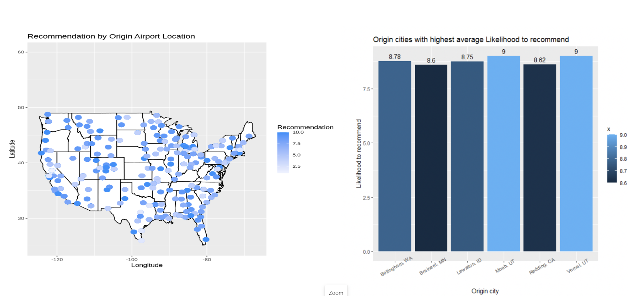

Slide 10
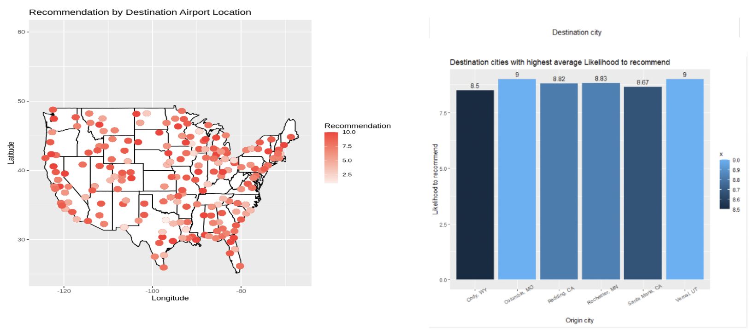

Slide 11
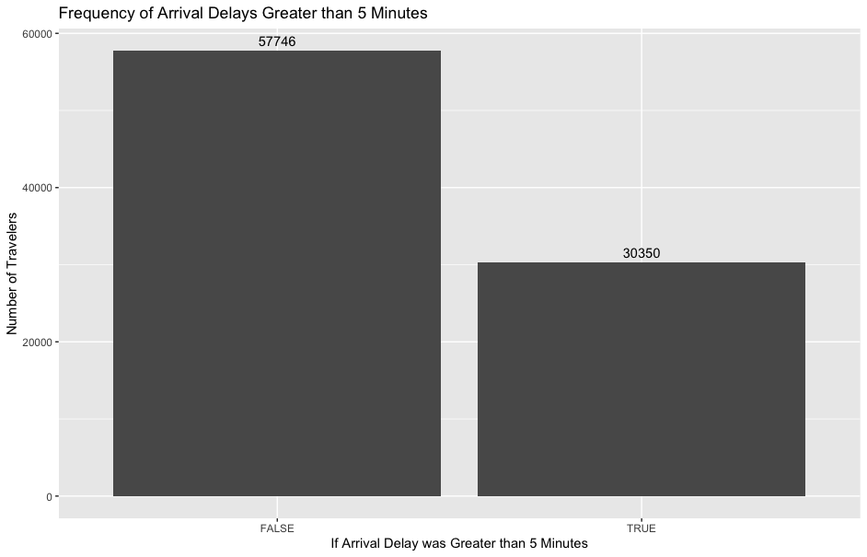
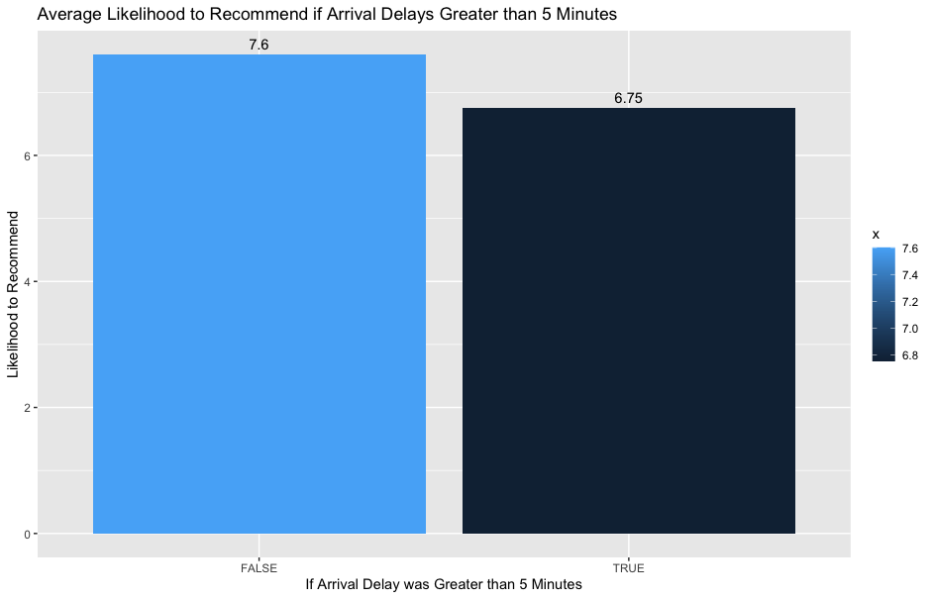
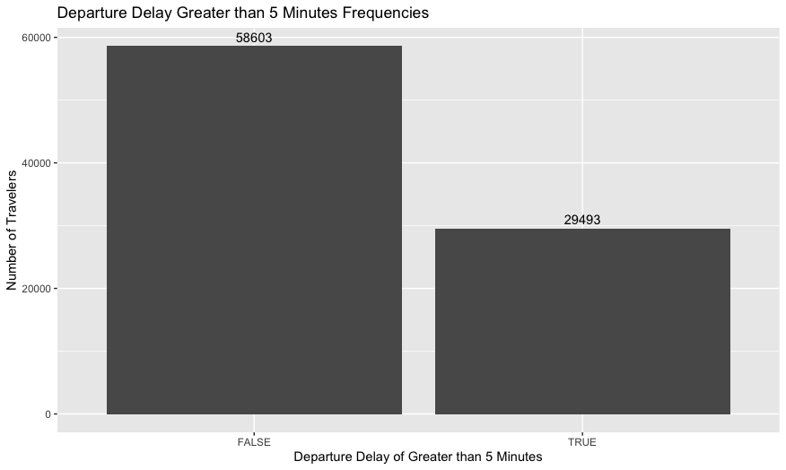
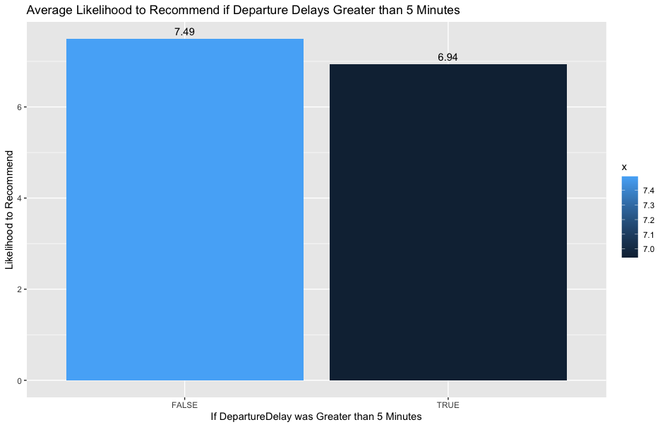
Likelihood to recommend scores fall when there is a delay

Slide 12
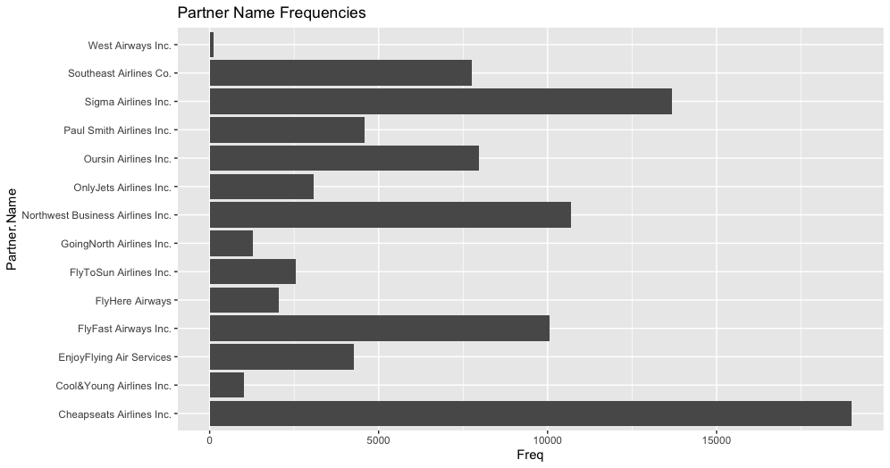
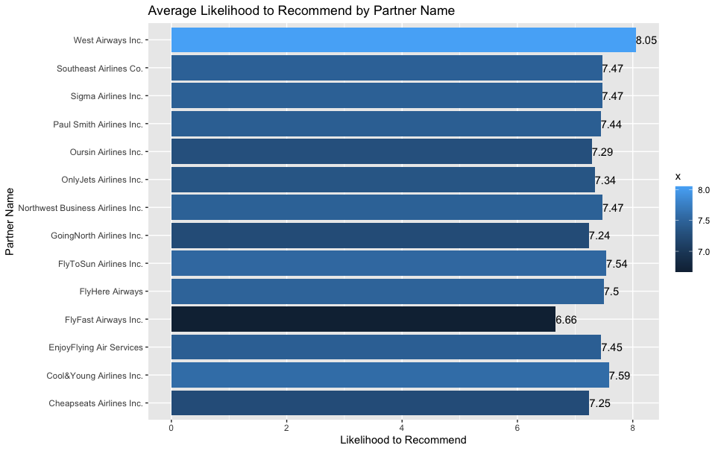
Likelihood to recommend scores wrt Partner name

Slide 13
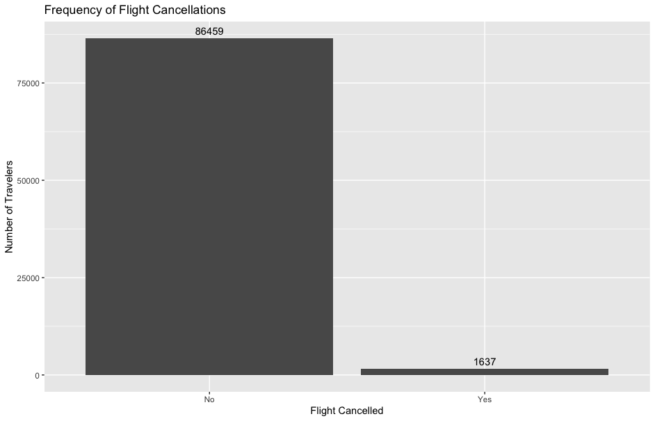
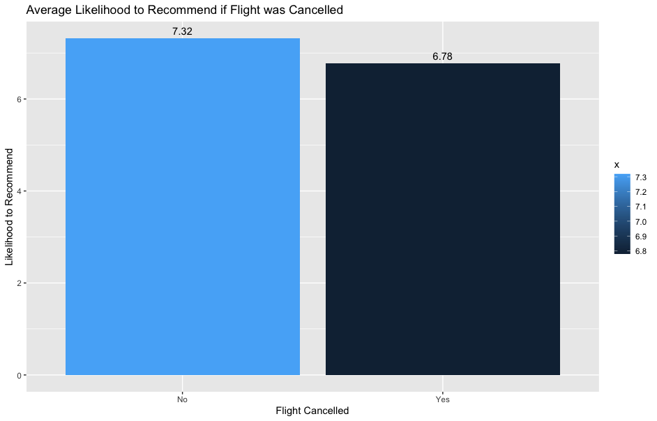
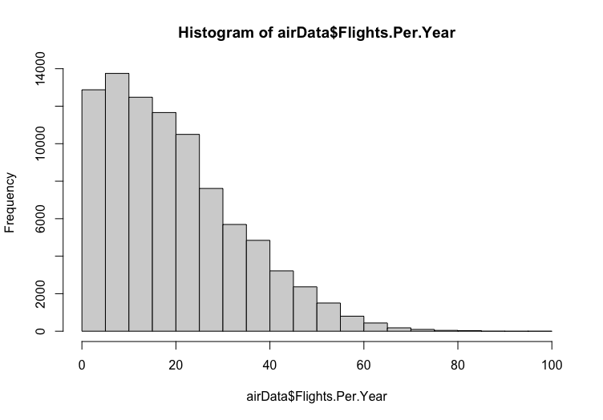
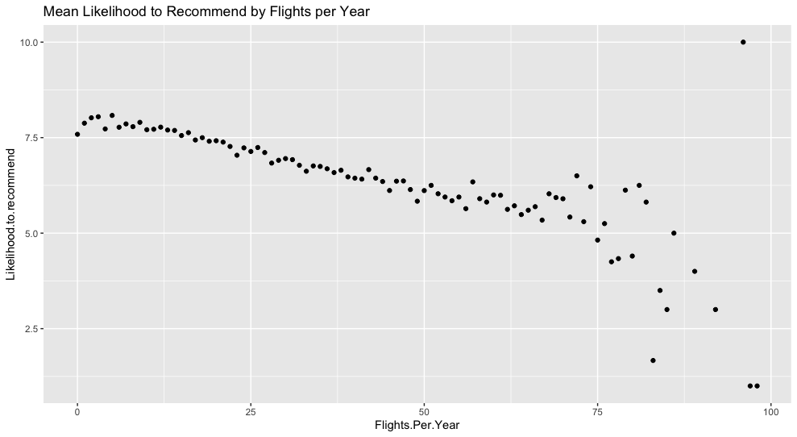
Likelihood to recommend wrt to flight cancelled and flights per year
Notes:
http://www.scielo.br/scielo.php?script=sci_arttext&pid=S2175-91462019000100300

Slide 14
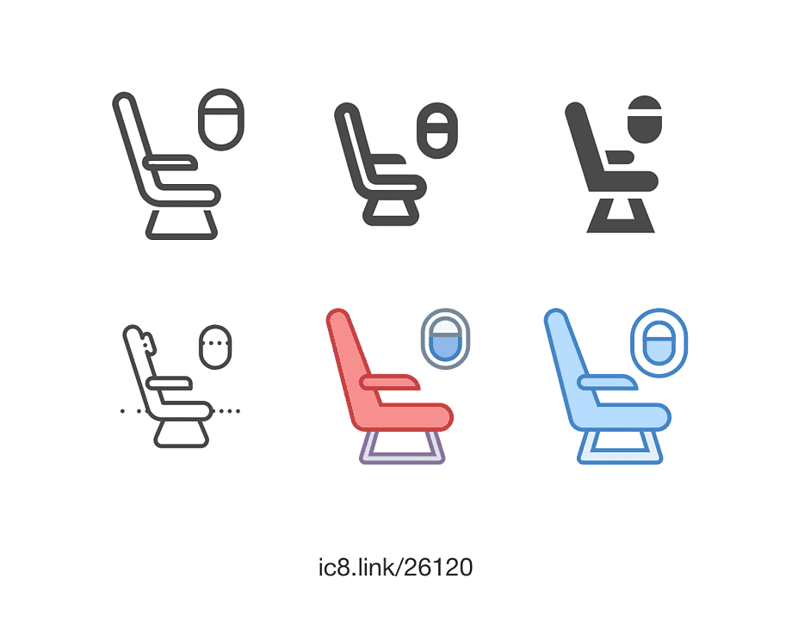
DETRACTOR GROUPS
9.78%
Age=60-85 Age, Airline Status=Blue, Eat at Airport
10.19%
Detractor groups
Age=60-85 Age, Airline Status=Blue
11.48%
Age=60-85 Age, Eat at Airport
11.95%
Age=60-85 Age
% of total travellers
Notes:
Age=60-85 Age 10,313.00 Age=60-85 Age, Eat at Airport 9,909.00
Age=60-85 Age, AirlineStatus=Blue 8,792.00
Age=60-85 Age, AirlineStatus=Blue, Eat at Airport 8,438.00
Class=Eco, Age=60-85 Age 8,303.00
Class=Eco, Age=60-85 Age, Eat at Airport 7,988.00
Class=Eco, Age=60-85 Age, AirlineStatus=Blue 7,094.00

Slide 15
PROMOTERS GROUPS
18%
Price Sensitivity=1,Age=33-59 Age, Eat at Airport
19.77%
No or < 5 mins delay in Departure, Age=33-59 Age
Detractor groups
19.97%
Price Sensitivity=1,Age=33-59 Age
21.31%
Class=Eco, Age=33-59 Age, Eat at Airport
26.14%
Age=33-59 Age, Eat at Airport
% of total travellers
Notes:
Age=33-59 Age,Eat at Airport 22,550.00
Class=Eco,Age=33-59 Age,Eat at Airport 18,383.00
Price Sensitivity=1,Age=33-59 Age 17,228.00
Price Sensitivity=1,Age=33-59 Age,Eat at Airport 17,057.00
No or < 5 mins delay in Departure,Age=33-59 Age 15,548.00

Slide 16
FEEDBACK
Positive feedback
About the staff-
Friendly, Courteous, polite, generous, hospitable, cheerful, helpful, attentive
Flight experience-
Smooth, safe, reliable, comfortable, efficient, enjoyed
Good, great, nice, best, excellent, pleasant Neat, clean
Notes:
To answer the question about what is causing traveller to give low ratings, we did some root cause analysis
So we can use the
Environment issues- uncomfortable-8, cramped-12, garbage-2, crowded-2, cramp-1, chaoti-1, chaos-2, immovable-1, smelled, dirty-1,noise,loud-1, unplesent-1, vibration-1, trapped-1
Service/ - rude,
Bumped- only 2- interesting
Positive feedback
About staff- friedly-28, smile-5, courteous-7, polite-7, enthusiasm-1, friendliness- 1, generous-1,hospitable-1,cheerful-1,helpful- 14,attentive- 8, comfortable-37
Flight experience- smooth-, smoother- 1,smoothly-1,safely- 2, reliable- 1,safe-1, upgraded- 1, enjoyed- 3,pleased-3,comfy-4, efiicient-9,scure-1,convenient- 1
free./cheap- free-11, complimentary-1,
Ambiance- neat-1, clean-5,cleaner-1

Slide 17

Recommendations

Slide 18
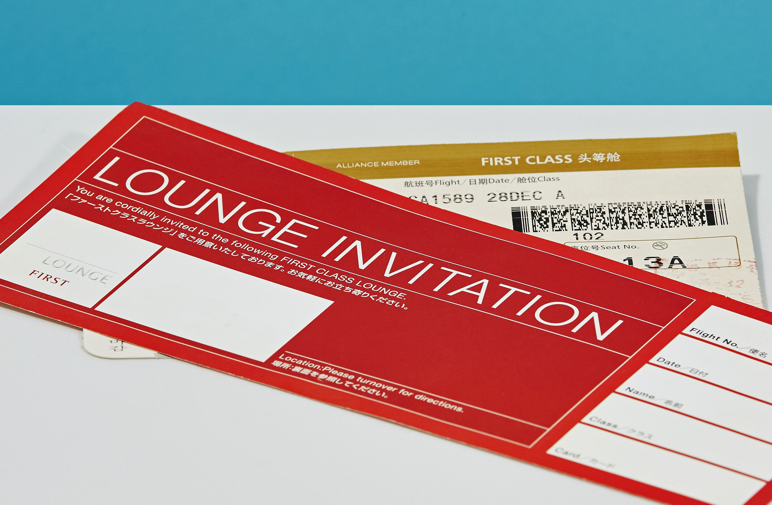
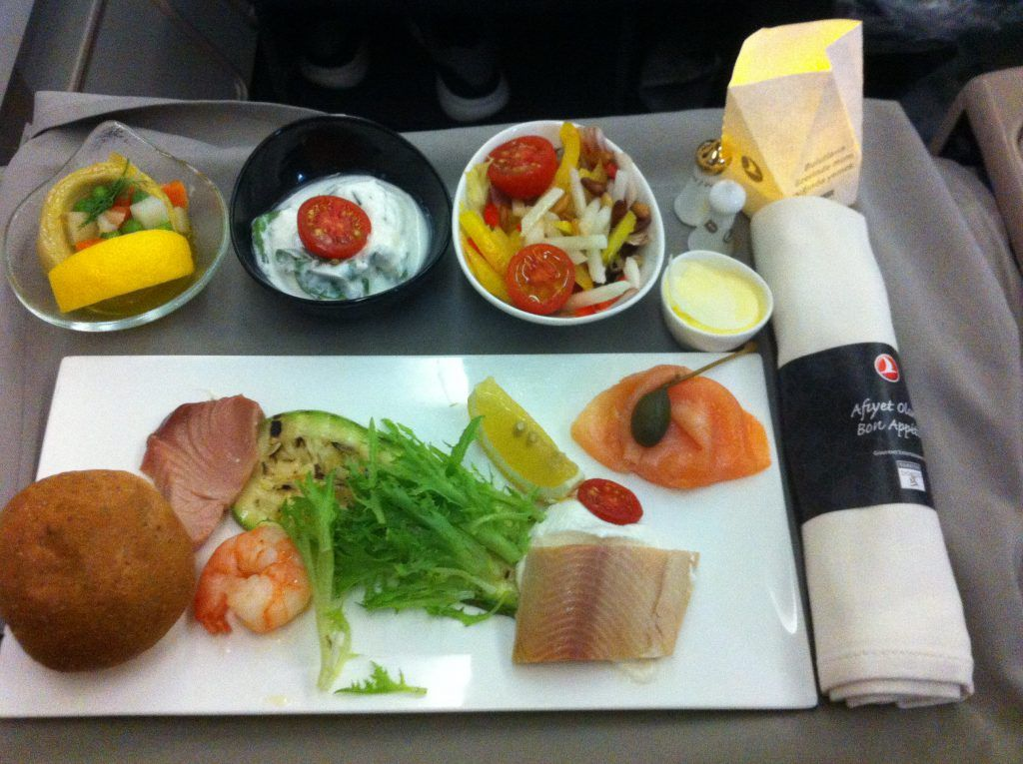
Recommendations
Flight Delays
Compensations through
Access to VIP lounge
Food/Snack vouchers or gift cards that passenger can avail in flight or at the airport(sent digitally)
Complimentary snack
Airline status
More opportunities for Blue status members to upgrade to Silver and Gold status though point system
Notes:
Giving a refund would cost the flight because some delays are unavoidable
We can give a discount to buy next ticket, but if the passenger is not happy with the service now they might not want to travel again
So we have give then access to business louge
And food gift vouchers that they can avail at the airport or in the flight
This way we make sure that the passenger is compensated in the present and the passenger does not carry the negative feedback along with him/her
Sent digitally so that the user when waiting for the flight can eat at the airport

Slide 19
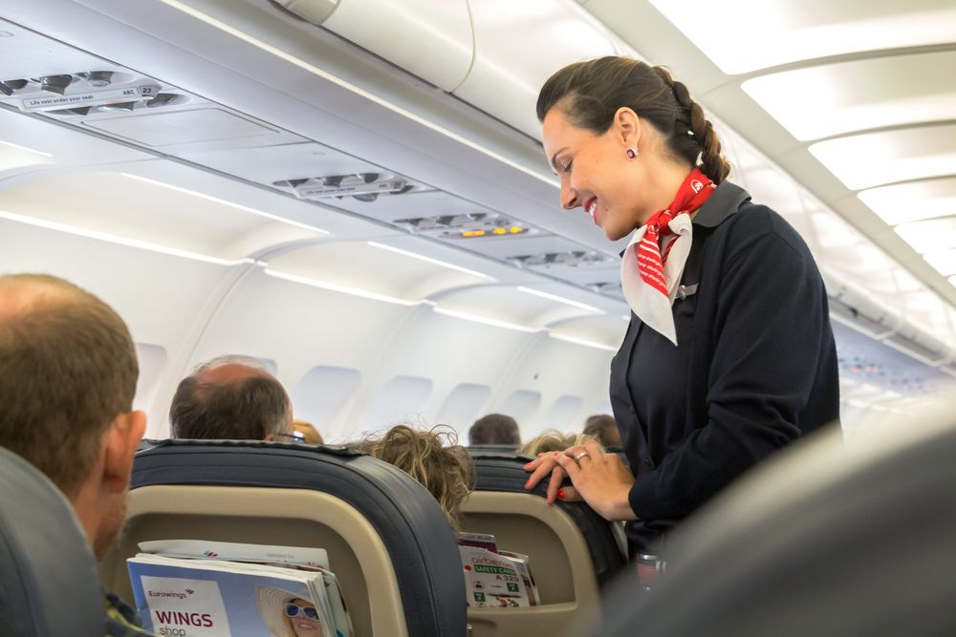
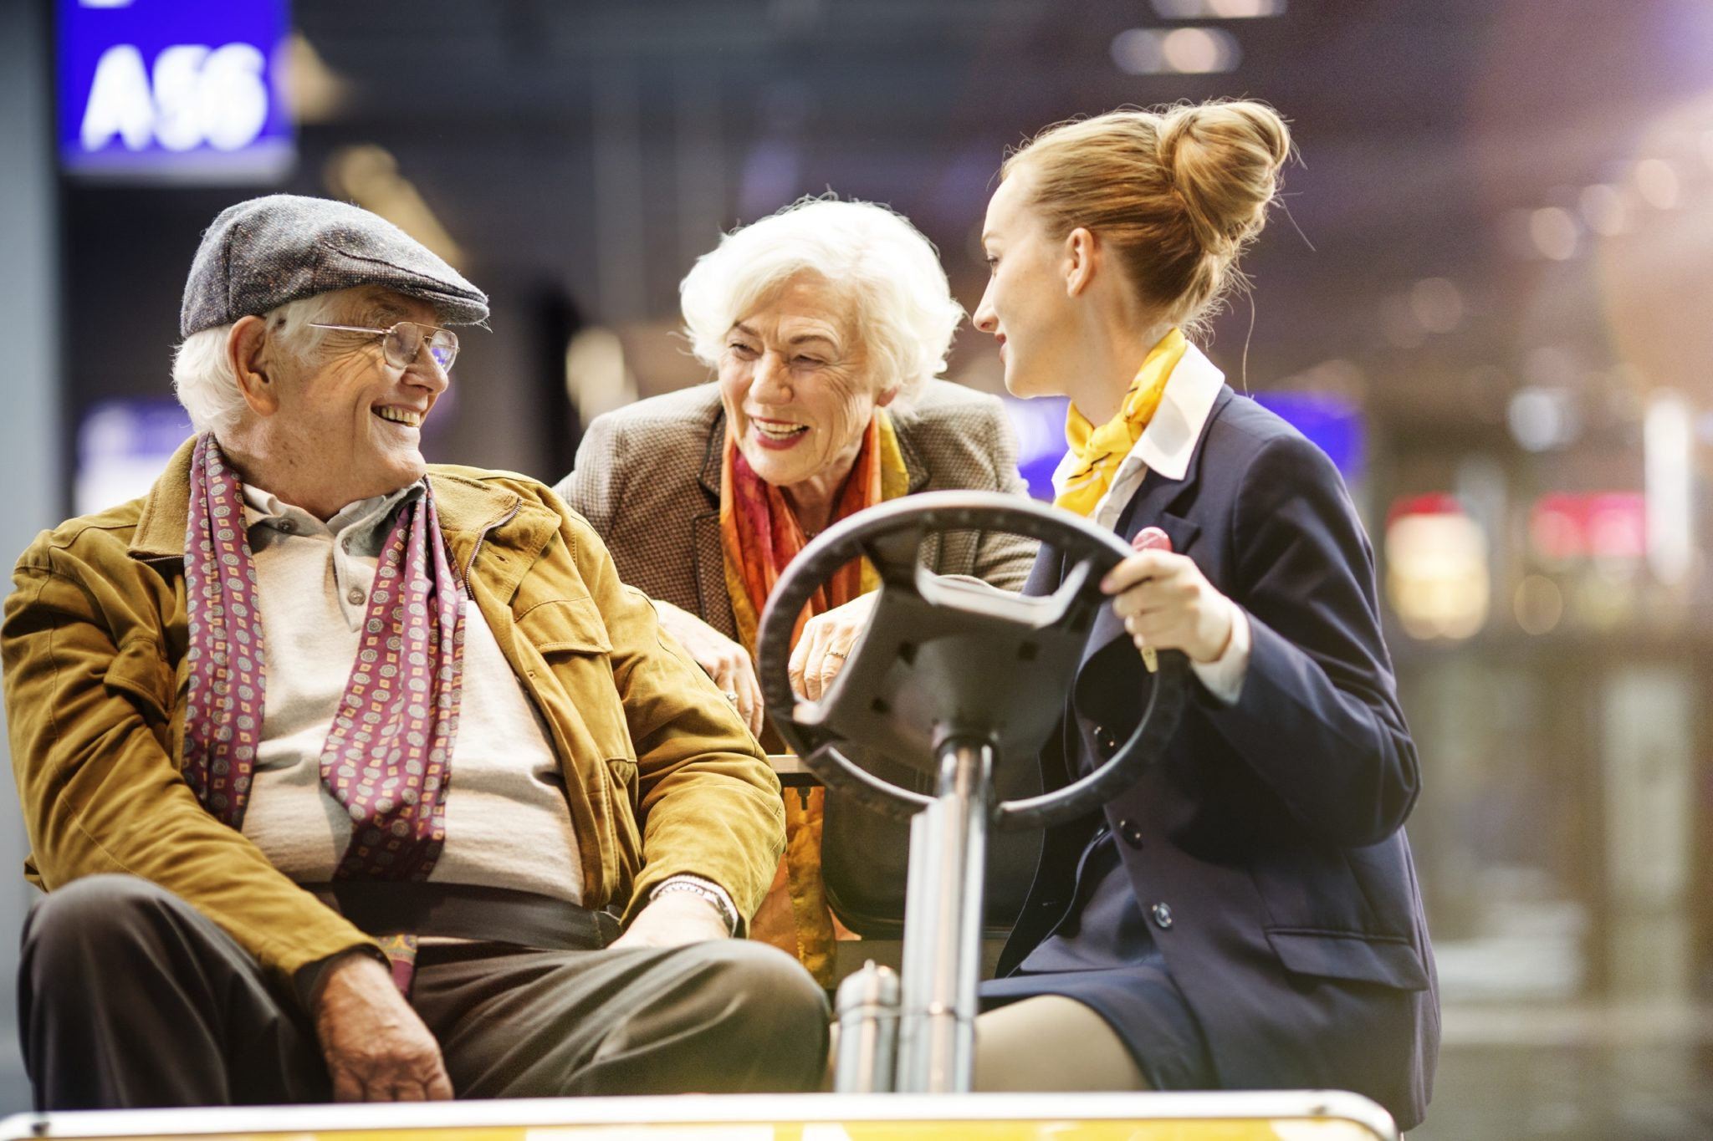
Recommendations
Senior citizens
Special care and attention to senior citizens
Checking up on them
Making sure they are comfortable- pillow/blanket
Meal on time (as they have to take medicines)
Pricing
Customer retention and engagement-
Point based system to attract price sensitive demographics
encourage them to keep flying with us
Type of travel
Personal travel passengers may be going for vacation
So we need to make their flight as enjoyable as possible.
May be give them vouchers of museums or theatres by collaborating with them
Notes:
Age- special treatment for senior citizens
Check on them if they need blankets or pillow-
If a individual has any special requirement – like is diabetic and needs food by a particular time- that arrangement should be made
At the check in if individual is above 60, we should ask we they need anything
Remind about medicine
Check on them more frequently
These things will not cost the flight much but make a huge difference

Slide 20
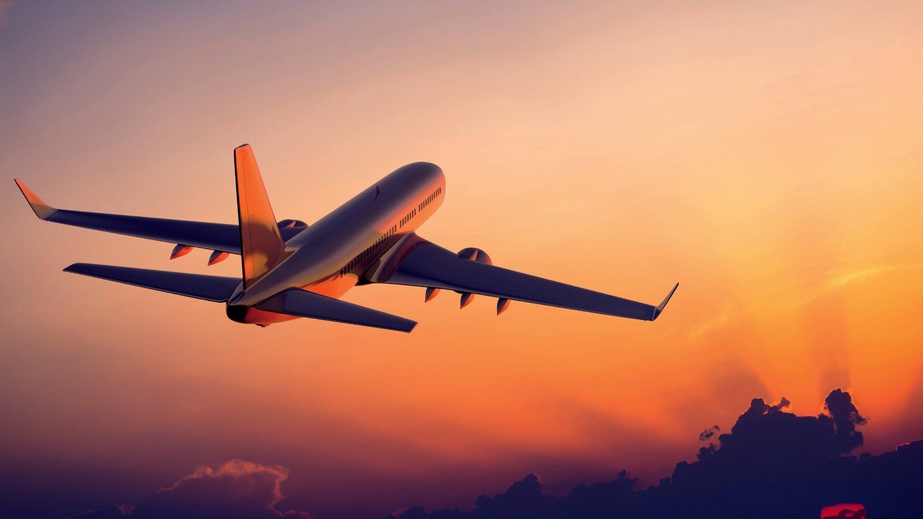
THANK YOU

Slide 21
